Slide 1

Walmart-Data Retail Analysis
How did 45 stores did in 2010, 2011, 2012
Factors affecting sales

Slide 2
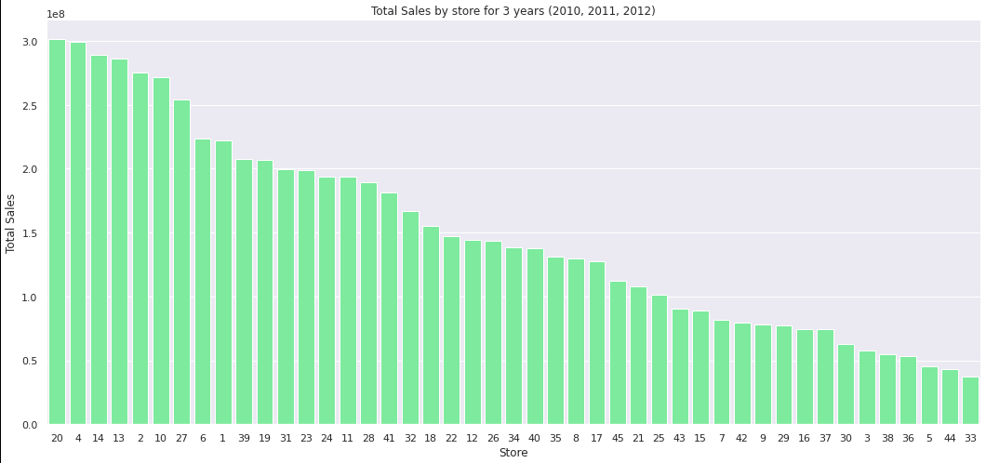
Total sales by store for 3 years
Hypothesis Test:
Null – No significant difference
Alternate - Opposite is true WINNER

Slide 3
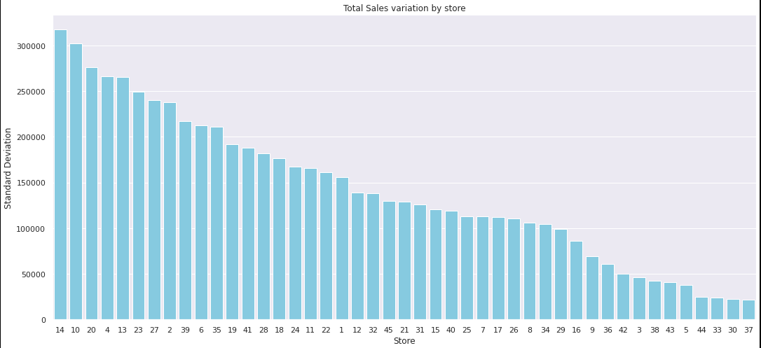
Sales variation by Store

Slide 4
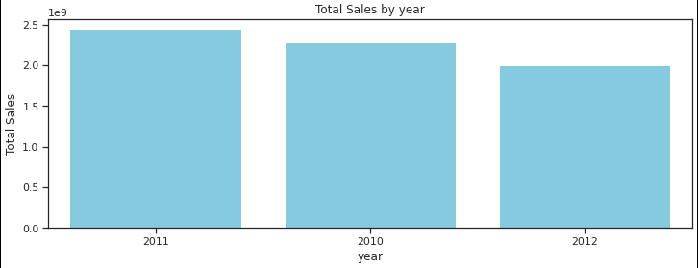
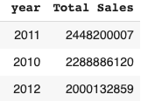
Which year did better, for all stores combined ?

Slide 5
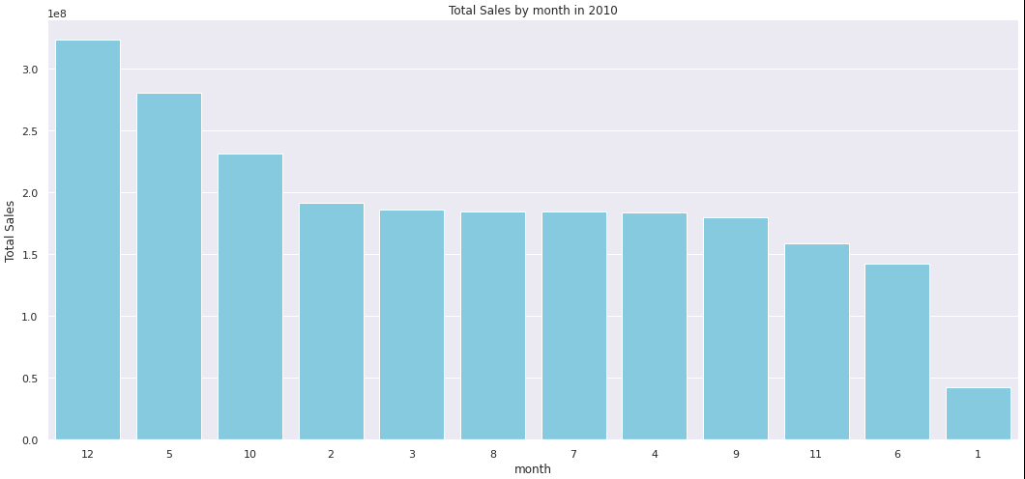
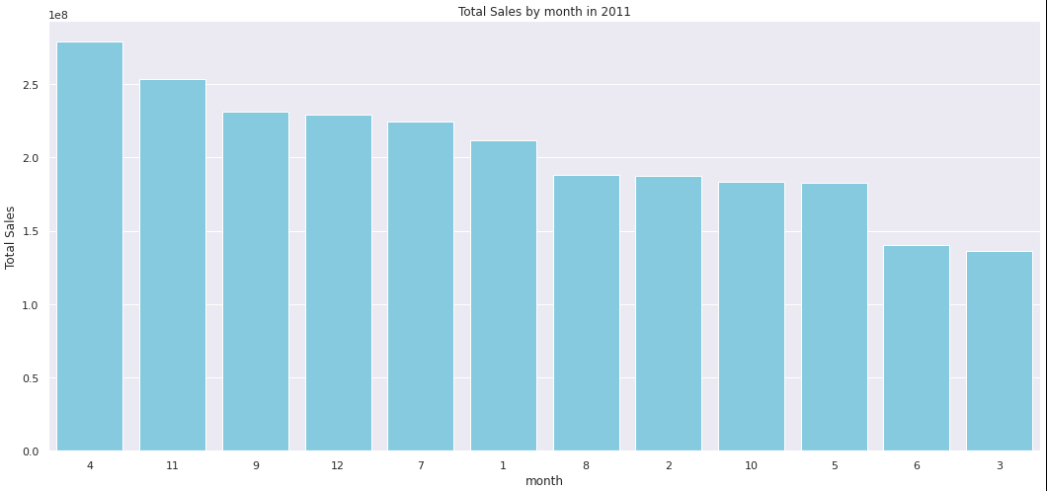
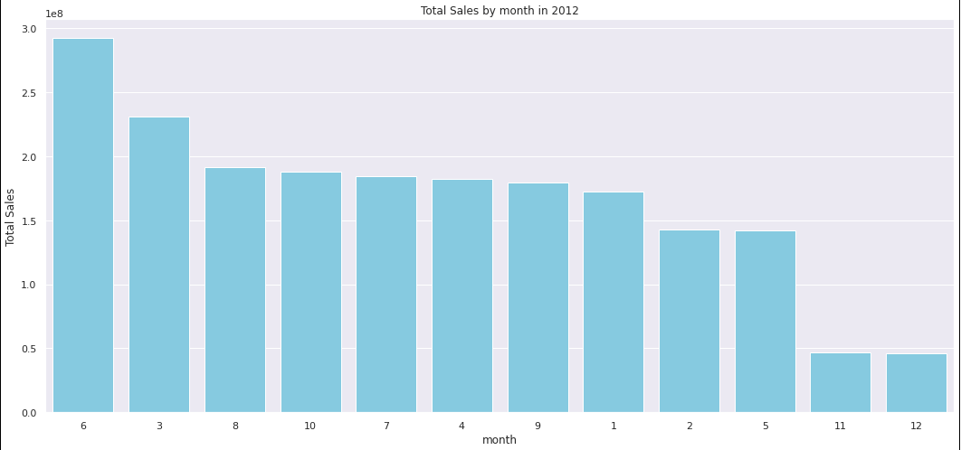
Which months did better over years ?

Slide 6
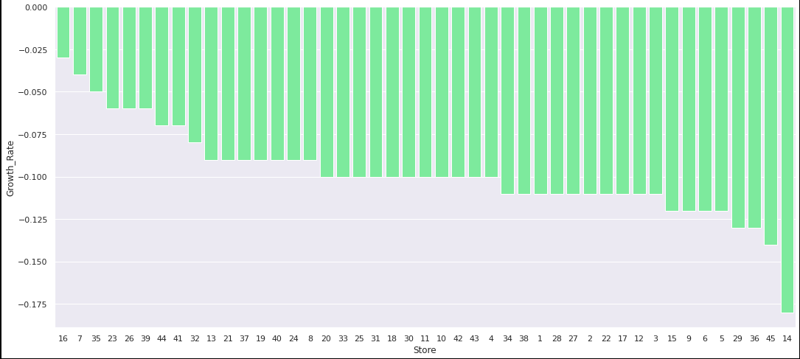
Most recent quarter (Q3,2012) growth rate of stores – IT’S A LOSS

Slide 7
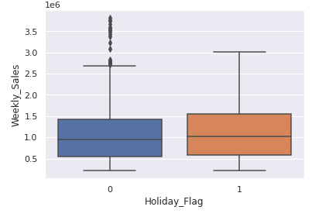
Holidays impact on sales
Hypothesis Test:
Null – Same sales on Holidays vs Non-holidays
Alternate - Opposite is true
WINNER
Flag 1 – Holidays
Flag 0 – Non-Holidays

Slide 8
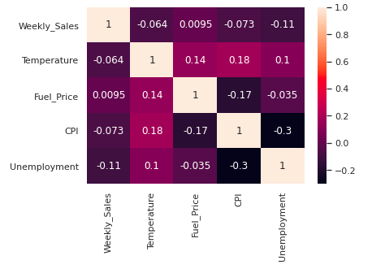
External variables impact on sales
Not really

Slide 9
So, what’s the point?
Benefits of Analysis: Use outcomes to meet business objectives
Make better decisions in planning, such as:
Inventory planning
Promotions planning
Network planning
Distribution planning

